Slide 1


Smart Produkt Solutions Assignment 5 – Project Management Methods SPS bbM, WS 2017/18

Slide 2
HANDOUT NICHT VERGESSEN
Assignment 5 – Project Management Methods
Planning vehicle for „Mars Expedition“
Anna Duregger,
Christoph Jungwirth,
Christian Gruber
22.01.2018
Project Management Methods - "Mars Expedition"

Slide 3
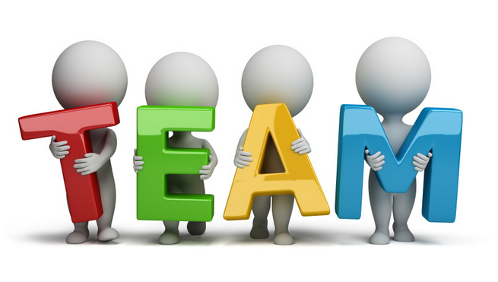
Project use case
Distribution of roles
Project manager and deputy project manager
Head of construction
Head of computer engineering
Head of electronic engineering
Decision maker
Responsibility
Quelle: http://www.flensburger-budo-club.de/attachments/Image/team.jpg?template=generic
22.01.2018
Project Management Methods - "Mars Expedition"

Slide 4
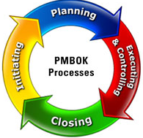
Project use case
Phase planning
Conception phase
Define and Planning phase
Execution Phase
Closing Phase (Mars Landing)
Structure
Set up activities
Work step by step
Quelle: http://www.mpmm.com/images/pmbok-processes.jpg
22.01.2018
Project Management Methods - "Mars Expedition"

Slide 5
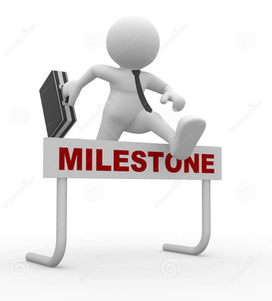
Project use case
Milestones
1st: Structure, basic concept, distribution of roles
2nd: Prototyping our Mohne
3rd: Optimization for our finalisation phase
Control project progression
Relief project planning
Quelle: http://laoblogger.com/images/milestone-clipart-10.jpg
22.01.2018
Project Management Methods - "Mars Expedition"

Slide 6
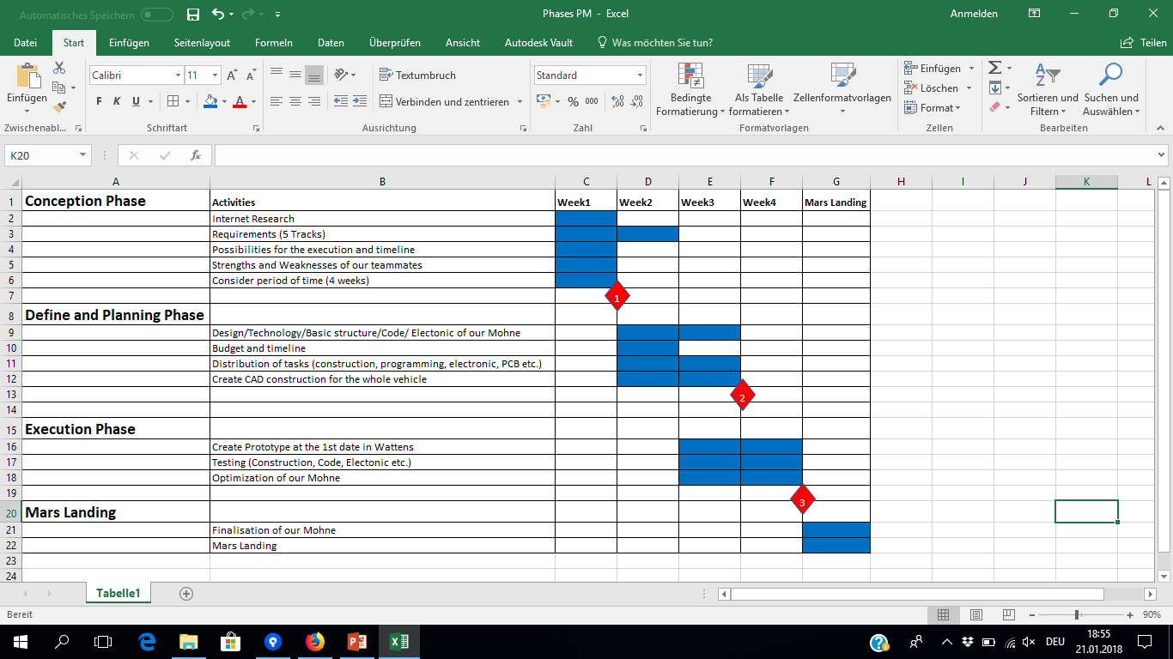
Project at a glance
22.01.2018
Project Management Methods - "Mars Expedition"

Slide 7
Project supporting tools
GitHub
Used as a Collaboration Tool for the Project
Separate the Tasks regarding the project phases
In addition to the project plan → more clearly & detailed
Templates (based on Excel)
Project owner Requirements (Tasks for the Robot)
Team Member Structure (Who is Who?)
Risk analysis (for the Robot)
Technical Requirements (Construction)
22.01.2018
Project Management Methods - "Mars Expedition"

Slide 8
Project supporting tools
More Tools
Visio for the team structure
PPT
Eagle (structure and planning of the circuit board)
Inventor for the construction
22.01.2018
Project Management Methods - "Mars Expedition"

Slide 9
Risk evaluation of the Project
Evaluating potential Risks of the Project regarding the customer requirements
Create controlling tools for the detected risks
Finding solutions for the come out risks
Discriminate between project risks and standard risks
Standard risks | Project risks
Competing goals | Technical Issues
Project environment | Time Table / Delivery Schedule
Stakeholder | Customer Requiremants
22.01.2018
Project Management Methods - "Mars Expedition"

Slide 10
Traditional vs. Agil Methods
Traditional project management:
What‘s the overall plan and conditions - in our Project?
Specificationlist
Riskanalyses
Define goal
Work off Workpackages
Document the progress
Work off Workpackages
Document the progress
Initiation
Execution
Closing
Planning
Monitoring & Control
Milestoneplan
Determining resources
Define Workpackages
Control scope, progress, cost
Readjust the projectplanning
22.01.2018
Project Management Methods - "Mars Expedition"

Slide 11
Traditional vs. Agil Methods
Traditional project management:
Goal of traditional project management - in our project?
In our case:
TIME
COST
QUALITY
TIME
COST=Budget
QUALITY? – We will see
SCOPE
SCOPE
22.01.2018
Project Management Methods - "Mars Expedition"

Slide 12
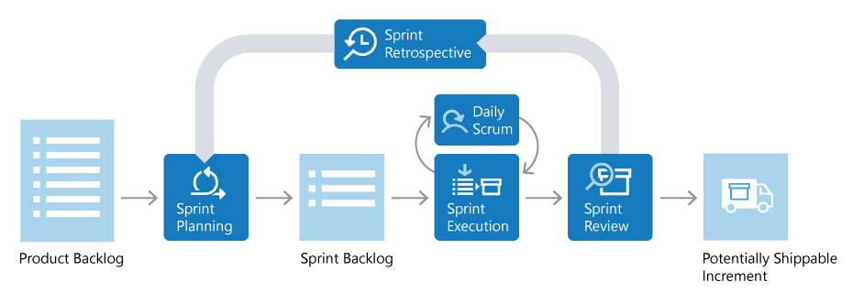
Traditional vs. Agil Methods
Agil project management:
Agil developement in our project?
Daily communication via whatsapp and github (for CAD and sourcecode)
Our „To Do“ on github
Review with the complete team over all accomplished workpackages
„In progress“ on github
Source: https://www.visualstudio.com/de/learn/what-is-scrum/?rr=https%3A%2F%2Fwww.google.de%2F
22.01.2018
Project Management Methods - "Mars Expedition"

Slide 13

Traditional vs. Agil Methods
Conclusion:
Traditional | Agil
Formal and hierarchical – straight forward | Informal, decisions are made in the entire team – loops possible
Anticipation: No changes during the project | Adaption: Embraces changes
Early planning and complete overview is key to success of the project | Fest reaction and adoption during the project is key to success
Overall planning
Developement
22.01.2018
Project Management Methods - "Mars Expedition"

